Slide 1
Morality and Memory, Disobedience
Disobedience reconsidered: history, theory, and the Morality of Scholarship Martin L. Davies School of Historical Studies, University of Leicester, Leicester, UK
Bryce Hickerty

Slide 2
Morality
Changing concepts of ‘normal’ moral behaviour as influencing and reflecting industrial, technological, and economic changes.
Adherence to ‘separate spheres’ ideology begins to be challenged as these influences change.
s
Disobedience reflects when arbitrary norms become challenged.
Disobedience shapes and reflects our concepts of history.

Slide 3
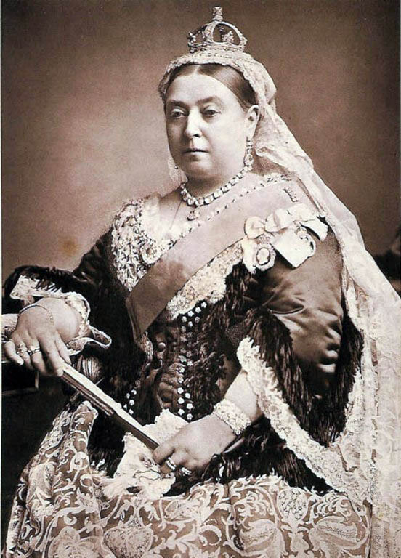
Victorian era and Victorian morality. Sexual restraint Intolerance for crime and vagrancy Strict code of public conduct Non-verbal communication of sexual feelings: Language of flowers

Slide 4
Protestant Work ethic:
The belief that hard work, discipline and thrift are key to success, happiness, and salvation.
Foundation for the ‘Just World’ hypothesis.
Economically motivated, adaptational.
In times of scarcity such as the Depression, this view shifts.
View begins to shift back as it becomes obvious the lack of individual control over conditions.

Slide 5
The Industrial Revolution and ‘separate spheres’
Previous to the Industrial revolution, production depended on the work of the master-apprentice system, in which work often took place within the home
With the mechanization of capital, work began to be considered separate from home life, as production shifted to factories.
The concept of ‘separate spheres’ became commonplace, and it was widely believed women had an inclination to domestic work.
Surplus capital fuels the ‘American Dream’ of success through capitalist pursuit

Slide 6
War and Morality
First World War
Women take a greater role, support men overseas
Women gain the vote in 1918,
Declared ‘persons’
‘Separate Spheres’ begins to be chipped away, women gain more rights, autonomy.

Slide 7
The Great Depression
Economic hardship as a motivator for the decline in the ‘Just World’ hypothesis.
Less autonomy over conditions, decline in the belief in a just world.
Thrift an increasingly prevalent value

Slide 8
World War II
Again, the second world war was incredibly influential in breaking down the ideological concept of ‘separate spheres’ as women increasingly took on previously masculinized roles in order to help support the war effort
However, women’s participation in the war effort was most often framed within the context of their roles as nurturers or caregivers
Post-WWII optimism due to economic prosperity

Slide 9
1984
Brian Mulroney, Conservative government
Ronald Reagan, ‘Moral Majority’
Resurgence of 1950s post-war optimism, response to Vietnam
Emphasis on conservation, cutting spending, war on drugs, return to the idealization of the ‘nuclear family’
And so, disobedience from social norms such as the expectations of male and female roles reflects and creates our concept of history and morality.
Social, economic, and political forces also greatly influence concepts of common morality and shape how history and social norms are conceived, as a result lending voice and giving autonomy to previously ignored groups.

Slide 10
Disobedience
Davies postulates that disobedience is defined as the opposition and challenge to an apparent unassailable order of the world
Through disobedience, argues Davies, historical fact is challenged and a given state of the world is examined for its arbitrary rules and norms. Such as ideological concepts of ‘separate spheres’.
History as an abstract tool for capitalism, documenting the past and using that data to successfully pursue capitalist endeavour
History “academicizes, which means it historicizes, which means it neutralizes”
That is to say, the mechanism by which history works is through disobedience, or challenging perceived social norms, conclusions, and dominant thought.
Historians reflect and shape current concepts of morality

Slide 11
Sources
http://www.scottish-country-dancing-dictionary.com/dance-crib/queen-victorias-visit-quadrilles.html
Albrow, Martin. (1990). Max Weber’s Construction of Social Theory. London: MacMillan
Davies, Martin L. “Disobedience Reconsidered: History, Theory, and the Morality of Scholarship.” Rethinking History, 17, 2 (2013): 191-210.
Morgan, Cecilia, Commemorating Canada: History, Heritage, and Memory, 1850s- 1990s (Toronto: University of Toronto Press, 2016)
Neatby, Nicole et al., Social Control in Canada: Issues in the Social Construction of Deviance (Ontario: Oxford University Press, 1996).
Valverde, Mariana, The Age of Light, Soap, & Water: Moral Reform in English Canada, 1885-1925 (Toronto: University of Toronto Press, 2008)

